Slide 1
POLS0008
INTRODUCTION TO QUANTITATIVE RESEARCH METHODS
Week one: Understanding data
Dr Andreas Mastrosavvas (a.mastrosavvas@ucl.ac.uk)
1
Notes:
Hello everyone, and welcome to the Introduction to Quantitative Research Methods (POLS0008) module. Week 1’s lecture will be a general introductory session focused on “Understanding Data” - before, we start – let’s get some general information about this module out the way!

Slide 2
About the course
2
Notes:
But before we start, let’s talk about the course…

Slide 3
Description of the POLS0008 Course
This module will introduce students to the key tenets of quantitative methods (or statistics) in the social sciences. It assumes no knowledge of quantitative methods or statistical software. Hence, it caters for students from diverse disciplinary backgrounds and adopts a practical hands-on approach to learning, with tutor supported computer tutorials.
This module covers descriptive statistics (central tendency and variation), data visualisation, data access, probability, sampling, hypothesis testing, inferential statistics and ends with an introduction to simple linear regression. Students will be introduced to the R statistical software and work with real-world data
3

Slide 4
Objectives of POLS0008 Course
To develop your understanding
To introduce foundational concepts and key tenets of quantitative methods
Statistical methodology (i.e., exploratory and inferential)
To get you thinking critically about quantitative research findings
To provide you with practical experience with Statistics
To provide practical experience in working with secondary data and quantitative methods
Confidence building – tackling ‘statistics anxiety’
Become an R/RStudio programmer
Develop transferable skills
Coding, presenting research finding and writing
4

Slide 5
Professor Stephen Jivraj (Convenor)
stephen.jivraj@ucl.ac.uk
Office: 317, 1-19 Torrington Place
Office Hours: See Moodle
Meet the module tutors
Dr Andreas Mastrosavvas (Co-convenor)
a.mastrosavvas@ucl.ac.uk
Office: Room 345, 1-19 Torrington Place
Office Hours: See Moodle
5

Slide 6
Meet the Postgraduate Seminar Tutors
Angel Torres Guevara
a.torresguevara@ucl.ac.uk
European and International Social and Political Studies
Giovanni Hollenweger
giovanni.hollenwger.21@ucl.ac.uk
European and International Social and Political Studies
James Rice
james.rice@ucl.ac.uk
Department of Political Science
6

Slide 7
General format of the course
2-hour lectures
Weekly sessions every Tuesday 12:00pm – 02:00pm
Delivered by the module tutors
1-hour computer practical seminar
10 groups on Thursday from 09:00am, up to 02:00pm
These sessions are facilitated by the postgraduate seminar tutors
NOTE: All lectures and tutorials sessions are compulsory & will be delivered in-person.
7

Slide 8
Module Outline & Assessment
Exploratory Statistics (Andreas)
WK01: Understanding Data & Introduction to RStudio
WK02: Examining Data I (Descriptive Statistics)
WK03: Examining Data II (Descriptive Statistics)
WK04: Sourcing Data
Hypothesis testing & Inferential Statistics (Stephen)
WK05: Normal Distributions
WK06: Confidence Intervals
WK07: Measures of Difference
WK08: Correlation
WK09: Linear Regression
WK010: Regression Assumptions
Details about assessment
It’s a 3,000 words essay which will be based on secondary analysis of survey data. It is worth 100% of your final marks for this course. The deadline will be confirmed soon.
8

Slide 9
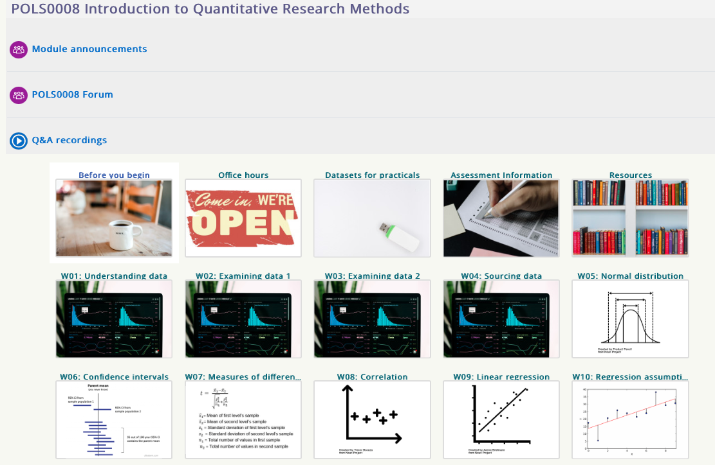
Access to the content on Moodle [1]
For module and seminar tutors for making an important announcement
For students to post questions on problems etc.,
Module outline document is contained here. Everything you need to know included read list etc is found there.
All our lecture and teaching materials are hosted in these sections. Click to access them.
9
Notes:
Moodle is an important part of this course – here is where you will have access all the lecture videos, and the practical & seminar materials (which includes the datasets, guidance notes and videos).

Slide 10
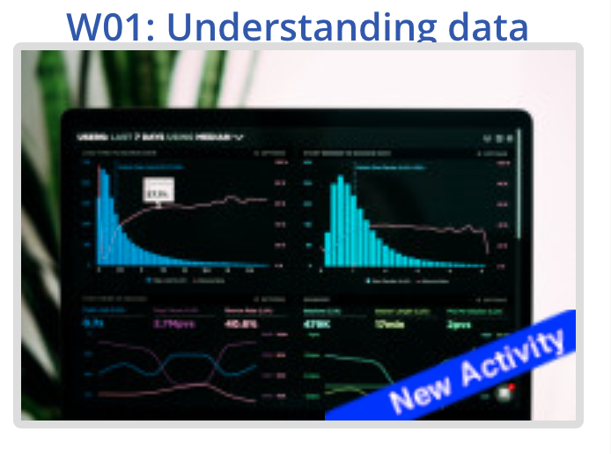



Access to the content on Moodle [2]
1.
2.
3.
All my lecture notes, reading lists, as well as guided videos and datasets for seminars for computer seminars are hosted on a GitHub website
10

Slide 11
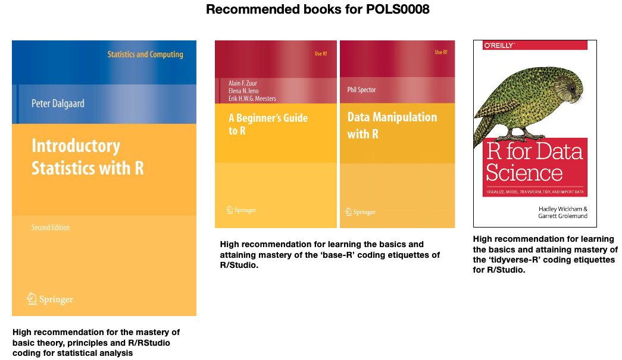
11

Slide 12
Lecture
12
Notes:
Alright now… let’s begin lectures now!

Slide 13
Contents
Problem
Why is statistical methods important?
What is statistics as subject?
Basic building blocks: Understanding the different data types
What is descriptive statistics and introduction to summary measures and frequency distributions?
RStudio and live demonstrations
Knowledge
Collect
Model
Wrangle
Explore
13

Slide 14
Format of today’s lesson goes…
Theory & Application
15-minute break
Live demonstration in RStudio
14

Slide 15
Why are statistical methods important?
15
Notes:
Alright now… let’s begin lectures now!

Slide 16
Why are Statistical methods important?
It’s an interdisciplinary subject with many applications
Social sciences (e.g., quantitative criminology, political science, housing markets and demography etc.,)
Epidemiology (e.g., finding associations between modifiable lifestyle risk factors and cancers; quantifying of risks environmental pollutants and respiratory tract disease in children etc.,)
Business and Marketing (e.g. understanding customer mobility and patronage at stores; customer behaviour etc.,)
Used for evidence-based research
Certain types of statistical methods are best for establishing evidence of a particular phenomena. It’s always best to use these methods with a observational study design framework (i.e., case-control, cohort or Randomised Control Trial (RCTs)).
16

Slide 17
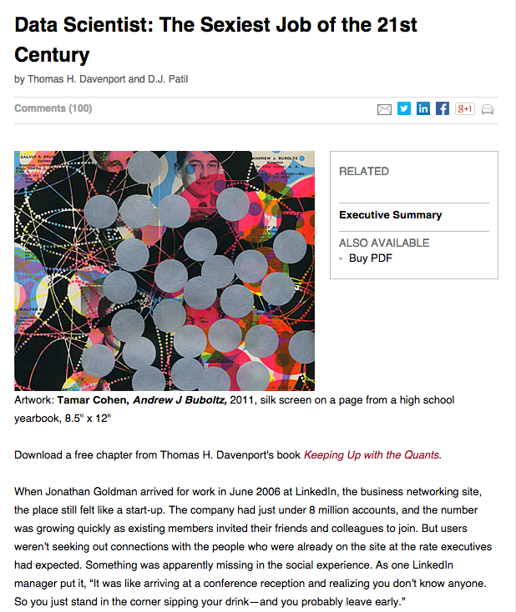
Why knowing statistics and data science is important?
Well… its incredibly promising in terms of career!
The “hottest skill set” that got people hired in 2014 (and since) is statistical analysis – and this is thanks to the growth of “Big Data”. Believe it or not, jobs which demands for statistics and data analytical skills are expected grow an astounding 34% by 2024. Therefore, by studying statistics, the science of studying & analysing from data, you are putting yourself in the ideal position for a career in one of the world’s most demanded.
Source: Harvard Business Review | [LINK]: http://hbr.org/2012/10/data-scientist-the-sexiest-job-of-the-21st-century/
17
Notes:
It’s best to narrate you own experience

Slide 18

18
Notes:
Why is it important… we need it to deal with Big data –
Big data is now evolved to into field which looks for ways to analysing, or otherwise dealing with data sets that are too large or complex to be dealt with by traditional data-processing application software.
In social science the term is often used to mean “bigger than an Excel spreadsheet”. It has become a buzzword, but one that has awakened people to the need for people to clean, manipulate and analyze data.

Slide 19
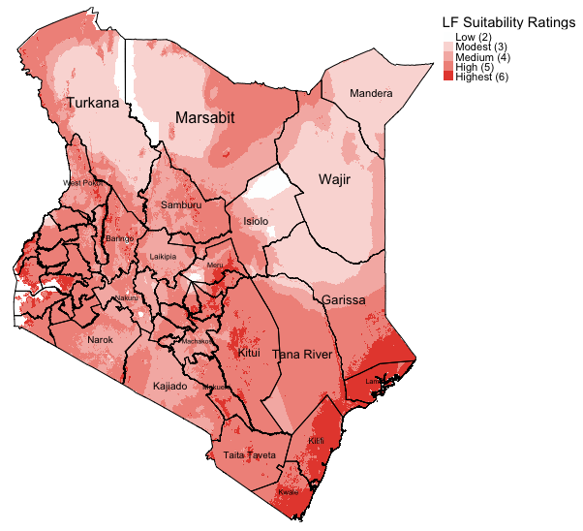
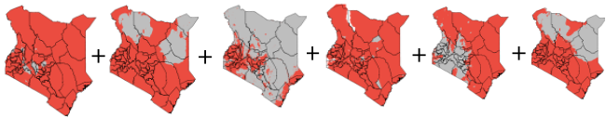


“Big” Analysis: identify suitable areas for Lymphatic Filariasis (LF) transmission in Kenya.
Combining 6 different environmental gridded data set to predict the spatial extents of where infectious disease are more likely to transmitted in Kenya
=
Sources:
1. Global Atlas for Helminths Infection (http://www.thiswormyworld.org)
2. ESPEN (https://espen.afro.who.int)
Example: Map generated in R to illustrate areas that are environmentally suitable for the spread of neglected tropical disease called ‘Lymphatic Filariasis (LF)’ in Kenya.
19
Notes:
An example of big data

Slide 20

Source: Cheshire, J., Uberti, O. (2014). London: The Information Capital, DNA of the City (Census variables reveal London’s genetic code), chapter 2: Who we are (Page 76).
20
Notes:
Another example of big data:
This image is an analysis of the 2011 census questionnaire for England – which contained a 56 questions that provided a broad spectrum of answers. This data set is a subset for London containing 3.2 million households alone covering several attributes age structure, living situation, martial status, ethnic group, religion and so many attributes group by London borough - the genomic visualisations where applied to this context to reveal London’s genetic make-up based on this sociodemographic characteristics

Slide 21
To think big, start small
This module is all about high quality data analysis.
“Small data” can be just as powerful.
“Big data” may contain a lot of noise.
Many of the methods are scalable
That is, they can be applied to datasets small and big.
All analysis should start with the same basic checks and descriptions of the data.
21
Notes:
In light of big data – as an data scientists its important to have a shrewd understanding of the various types of data structures. A shrewd understanding of the data informs the user/analyst on where to start with analysis – basic check

Slide 22
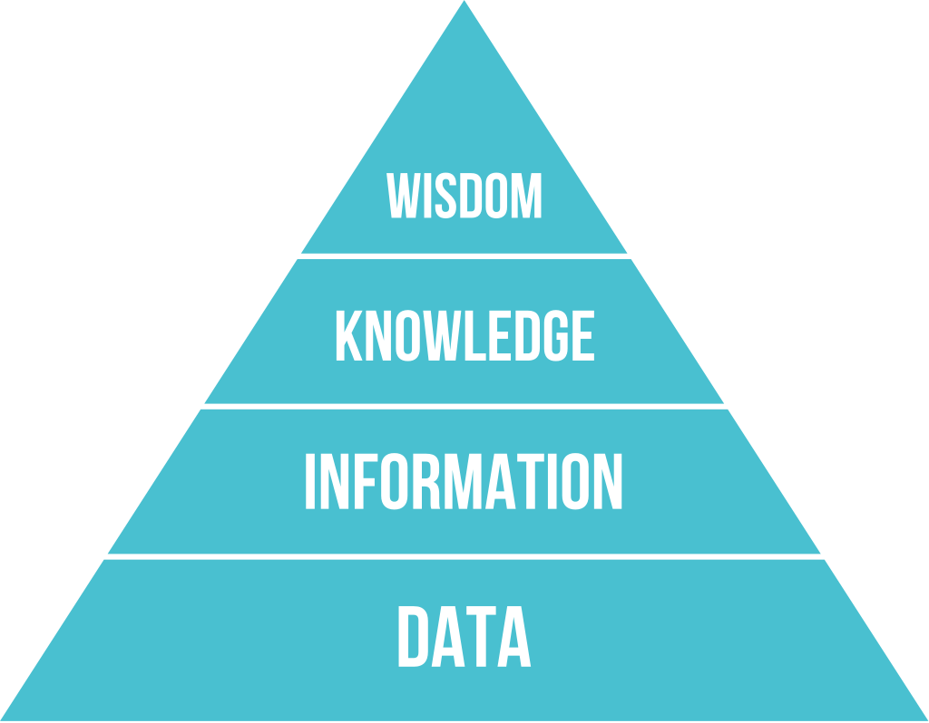
DIKW Pyramid
Data analysis is the process of inspecting, cleansing, transforming, and modelling DATA with the aims of gaining some useful insight (or INFORMATION) to help support decision making
DIKW is a useful framework for describing the relationship, or structural ‘stages’ (aka rites of passage) one must go through to gain KNOWLEDGE and WISDOM.
22

Slide 23
Data vs Information vs Wisdom
Data
Information
Evidence
Knowledge
Wisdom
Raw facts
Contents of a database assembled from raw facts
Results of analysis of many datasets or scenarios
Personal knowledge about places and issues
Policies developed and accepted by stakeholders
23

Slide 24
What is Statistics?
24

Slide 25
What is Statistics?
Composed of three main facets
Design
How to collect the data (i.e., probabilistic sampling approaches)
Description
Describing the way, the data looks
Summarizing the data that has been collected
Inference
Making predictions about the wider population or about the future
Specifically, statistical inference
The “descriptive” and “inferential” elements are what we refer to as statistical analysis
25
Notes:
Statistics is the discipline that concerns the collection, organization, analysis, interpretation, and presentation of data.
Statistics can be broadly split into two areas – descriptive statistics and inferential statistics

Slide 26
1st Statistical Terminology – Populations vs. Samples [1]
Population
The entire possible set of subjects we wish to study
These could be states, individuals, businesses, organizations, etc.
Sample
The subset of subjects chosen for study through data collection
26
Notes:
We use the term "Population” to simply refers data collection all members/subjects/items under consideration for an analysis.
Note that its impossible to have information about all members, or units of population, and therefore we collect a sample.
The term sample is basically a subset of members/subjects/items selected for study that’s representative of the population its from.

Slide 27
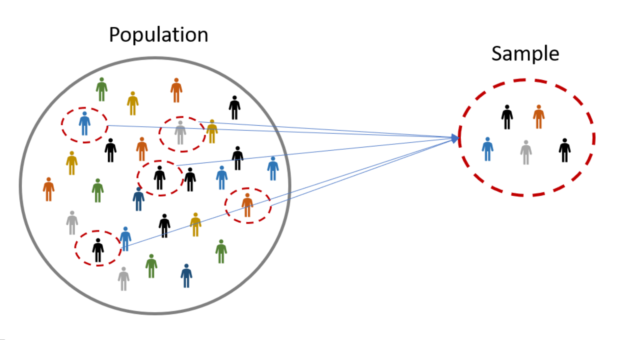
1st Statistical Terminology – Populations vs. Samples [2]
Full
3.
Therefore, we take a random sample from the population that is representative of UK, analyse this sample to know the percentage of people who would for the Labour Party
1.
Say, we want to know the percentage of people in the whole of the UK population who would vote for the Labour Party
2.
It is impossible, or it very tedious for us to collect data on everyone in the UK population
27

Slide 28
2nd Statistical Terminology – Parameter and Statistic [1]
Parameter:
A numerical summary about the OVERALL population
We rarely know true population parameters, so we use:
Statistic(s) (or estimate(s)):
A numerical summary of the sample data
Statistics generally contain two bits of information: 1) a measure of central tendency and 2) a measure of variability
We could use what we know about how the sample would vote to make inferences to the population
28
Notes:
A parameter is any measured quantity of a statistical population that summarises or describes an aspect of the “population”
A statistic or estimate is a numerical summary is any measured quantity of a statistical population that summarises or describes an aspect of the “population”

Slide 29
2nd Statistical Terminology – Parameter and Statistic [2]
Parameter: The proportion of people in the UK population who voted for the Labour Party ($p$)
Statistic: The sample proportion of people from the UK population voted for the Labour Party ($\hat{p}$)
Full
3.
Therefore, we take a random sample from the population that is representative of UK, analyse this sample to know the percentage of people who would vote for the the Labour Party
1.
Say, we want to know the percentage of people in the whole of the UK population who voted for the Labour Party
2.
It is impossible, or it very tedious for us to collect data on everyone in the UK population
29
Notes:
We could use what we know about how the sample feels about Boris Johnson to make inferences to the population

Slide 30
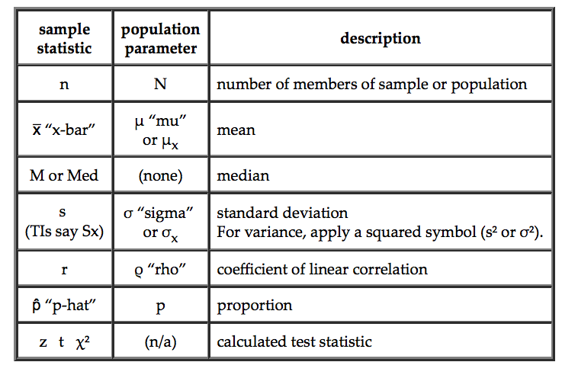
More (very basic) Statistical Notation
30

Slide 31
Basic building blocks: Understanding the different data types and variables
31

Slide 32
Type of Variables
A variable is anything that we can measure about the subjects in our sample
Variables vary, that is they take on a range of values
There are two classifications of variables
Levels of measurement: (Lowest) Nominal << Ordinal << Interval << Ratio (Highest)
Continuous Variables
Categorical Variables
Interval
Ratio
Nominal
Ordinal
32
Notes:
A variable can anything – its an attribute that describes a member of a sample – this can be person, place, thing or idea. The value of the variable can "vary" or change from one entity (i.e., person, place, thing or idea) to another.
A variable can classified into one or many groups etc.

Slide 33
Broad types: Continuous & Categorical Variables
Discrete variables contain data with countable items:
Number of crimes in London in the last month
Number of students in a class
Number of languages spoken
Continuous variables contains data with measurable items:
Age (in years: 25, 57, 45, 34, 38 etc.)
Monthly Income (in £££: 2399.68, £5569.89, £1123.10, £1,450.99, £3847.12 etc.)
Height (in meters)
Weight (in kg)
Categorical variables has categories or groups:
e.g., gender, ethnicity, employment status etc.,
33

Slide 34
Data types [1]: Nominal
Notes
Examples
Categorical measure
Discrete set of categories with no natural order
To distinguish groups with labels
May be referred to a qualitative or categorical variable
It is the lowest level of measurement
Gender
0 = Female
1 = Male
Race
1 = Asian
2 = Black
3 = White
Party membership
1 = Liberal Democrats
2 = Tory
3 = Labour
(Dichotomous or Binary)
(Polychotomous)
(Polychotomous)
34
Notes:
A Nominal variable is a type of categorical variable with given values that communicate differences between subjects on the characteristic being measured
Measurement differences are through name or labels only
The “lowest” level of measurement

Slide 35
Data types [2]: Ordinal
Notes
Examples
Categorical measure
Discrete set of categories that have some natural order
There categories have rankings but difference between rankings is not known
Order matters!
It is the 2nd lowest level of measurement (above Nominal)
Likert scale (strongly disagree, disagree, neutral, agree, strongly agree)
Socioeconomic status
1 = Working class (Low)
2 = Middle class
3 = Upper class (High)
Size
1 = Small (Low)
2 = Medium
3 = Large (High)
e.g., Size, ranking of favourite sports, wellness rankings etc.,
35
Notes:
An ordinal variable is a type of categorical variable with given values that communicate relative differences between subjects on the characteristic being measured. The categories in an ordinal variable cannot say precisely how much difference – what is certain is that there is some order to the categories;
It is the 2nd lowest level of measurement (above Nominal)

Slide 36
Data types [3]: Interval
Notes
Examples
Continuous measure
Unlike ordinal variable, difference between categories are known and equal (-must be known to calculate an interval)
Zero is arbitrary (meaning that whatever observation you measure it does not indicate that its non-existent)
2nd best level of measurement
measurement (above Nominal)
Example: Temperature in degree Celsius
The difference between 78 degrees and 79 degrees (i.e., is 1 degree) is the SAME as the difference between 45 and 46 degrees (i.e., is 1 degree again).
Measure of zero degrees Celsius indicates that it does mean that there is no temperature – it only means that its temperature at zero is at freezing point
In addition, it does not represent the absolute lowest value, since there are negative values for temperature
36

Slide 37
Data types [4]: Ratio
Notes
Examples
Continuous measure
Most precise
Exact value
Unlike interval measure, a zero value that there’s “nothing” there (not arbitrary)
Weight
Height
Income
House price
Crime rate
Age
37

Slide 38
3rd Statistical Terminology [1] – Dependent variable(s)
Dependent Variables
The variable to be explained, described or understood.
Sometimes called the “outcome”, “event”, or “criterion” variable
Mathematically, it’s most often denoted with the letter Y
The DV should be dependent upon something else (i.e., independent variables) and…
… it should NOT affect the independent variable (though this can happen and needs to be considered and accounted for)
Like most variables, DVs should vary, if you have a constant DV, you will not be able to explain the effect of other variables on it
38

Slide 39
3rd Statistical Terminology [2] – Independent variable(s)
Independent variables
It should be independent from the effects of the dependent variable (though maybe not always other independent variables)
Presumed as the determinant or cause, or something that impacts the dependent variable
It is interchangeable with the term “explanatory” or “predictor” variables. In epidemiology we often say, “risk factors”, in social sciences we say, “social-risk factors” etc.,
Always antecedent to the dependent variable being explained
Mathematically, it is often denoted as the letter X
Again, since it is a variable, the values measured should vary. For instance, think of age, income, employment rates, gender, level of democracy as socio-demographics risk factors for Gross Domestic Product.
Here, we are saying GDP is the dependent variable (or outcome of interest). We are asking ourselves how do these independent variables impact GDP?
39

Slide 40
What is Descriptive Statistics?
40

Slide 41
What are Descriptive Statistics?
Univariable analysis
Analysis of only one variable on some characteristic
Frequency Distributions – essentially a count or distribution of values on some single variable
Other descriptive statistics – some summary measure that describes the data in a way not obvious by looking at the frequency distribution
Bivariable analysis
Analysis of two variables – can be simple scatter plots or cross-tabulations
Multivariable analysis
Analysis of three or more variables
41
Notes:
Descriptive statistics are not used to make inferences to the population
Descriptive statistics (including frequency distributions) are a good way to get a first glimpse at data
Not very powerful in terms of analysis
Are a good place to start when you come across a new set of data
Best used as complements to other forms of analysis
Can be used for some qualitative work like case studies or to look at a larger pattern when investigating a micro-level phenomenon
Can be used with other forms of quantitative analysis to provide introductory remarks or support the forms of analysis being used

Slide 42
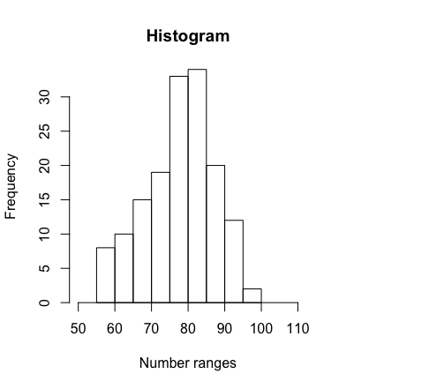
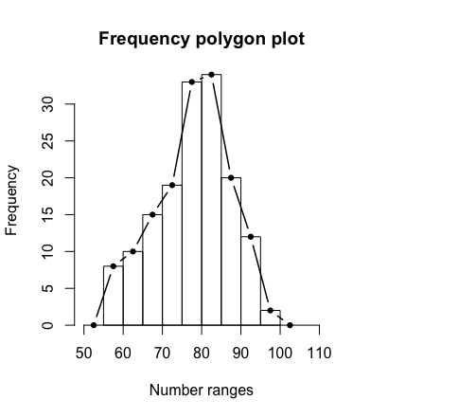
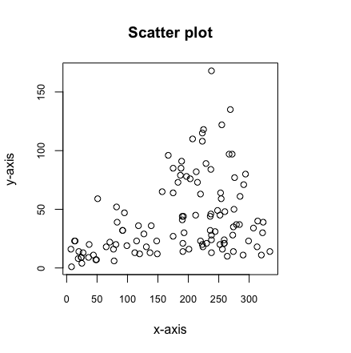
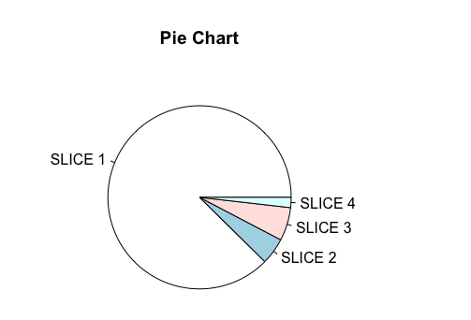
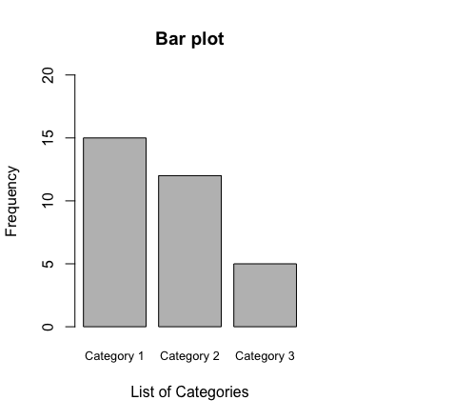
Continuous data
Univariable analysis
Bivariable analysis
Categorical data
42

Slide 43
Summary Measures
What kinds of analysis and summary statistics can you perform on a particular type of dataset?
1. Frequency distribution
2. Central tendency measures
You can group the data by according to categories and perform the following:
Numerical data grouped into categories
Compute the Frequencies (counts)
Compute the Percentages (or Relative Frequency)
Calculate the Cumulative Frequencies or Cumulative Percentages
Proper categorical data etc.
Graphical approaches also include bar plots and pie charts
The Mode (category with that occurs most)
You can perform the following analysis:
Compute the mode (value that occur most)
Compute the median
Compute the mean
Lowest (Minimum) & Highest (Maximum)
Percentiles
Variance
Standard deviation
Range
Quartiles and Interquartile ranges
43

Slide 44
Frequency Distribution
Can be represented as instances or frequency of an outcome of interest.
Example:
Heights (cm) of 21 (n) kids entering reception (aged 4 years). Health-wise, the normal height of a 4-year-old child should be on average 101cm and above:
Dataset: 94, 95, 97, 97, 100, 100, 101, 102, 103, 105, 105, 108, 108, 109, 109, 112, 113, 113, 118, 119, 121
We want to understand the frequency or the occurrence in heights among this cohort of kids.
44

Slide 45
We create a table that contains group categories for height (of 5cm) measurement, and compute the frequency and proportions. In addition, we compute the cumulative frequency and its cumulative proportion as well.
94, 95, 97, 97, 100, 100, 101, 102, 103, 105, 105, 108, 108, 109, 109, 112, 113, 113, 118, 119, 121
Height groups | Frequency | Relative Frequency or percentage (%) | Cumulative Frequency | Cumulative Relative Frequency
90-95 | 2 | 0.09523810 (9%) | 2 | 0.09523810 (9%)
96-100 | 4 | 0.19047619 (19%) | 6 | 0.2857143 (28%)
101-105 | 5 | 0.23809524 (24%) | 11 | 0.5238095 (52%)
106-110 | 4 | 0.19047619 (19%) | 15 | 0.7142857 (71%)
111-115 | 3 | 0.14285714 (14%) | 18 | 0.8571429 (85%)
116-120 | 2 | 0.09523810 (9%) | 20 | 0.9523810 (95%)
120+ | 1 | 0.04761905 (4%) | 21 | 1.0000000 (100%)
We group the data points accordingly
94, 95
97, 97, 100, 100
101, 102, 103, 105, 105
108, 108, 109, 109
112, 113, 113
118, 119
121
This output is called a “Frequency Distribution table”, it’s visual representation is a histogram for the data’s relative frequency and cumulative frequency plot for the cumulative frequency.
45

Slide 46
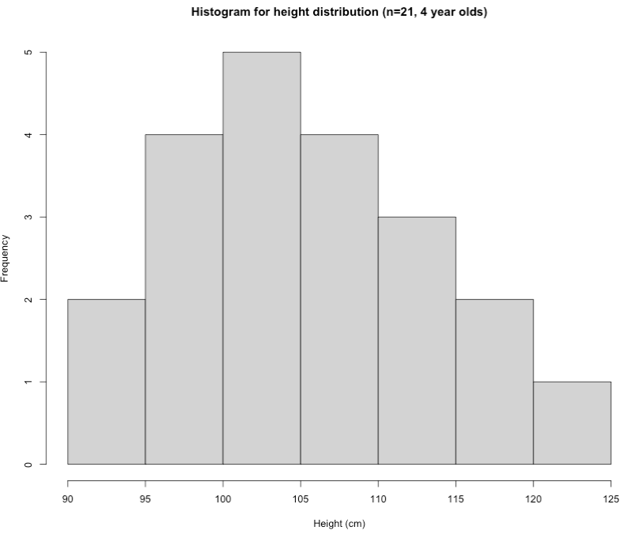
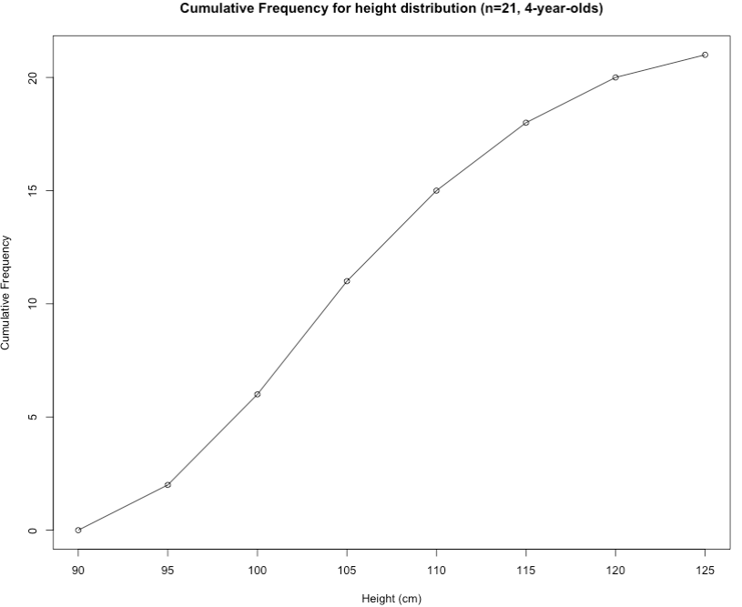
Interpretation: The above table output show the frequency distribution of heights (in cm) in kids who are 4 years of age entering in reception. The group with the highest frequency was 101-105 cm which accounts for 24% of the data. Health-wise, we can see from the cumulative frequency results that there are 6 kids with height values that are less than 101 cm. This corresponds to 0.2857 (29%) of the data – descriptively, these 6 kids growth is a cause for concern.
46

Slide 47
Break
47

Slide 48
RStudio and live demonstration
48

Slide 49

What is R/RStudio
The r-project for statistical computing: https://www.r-project.org
Open-source RStudio: https://www.rstudio.com
The R Journal: https://journal.r-project.org
49
Notes:
R/RStudio: its a free open-source statistical computing language that’s used extensively by academics, business and policy researchers;
And what I mean by open source as well, the software is community-led by the ‘R project’ and this could anyone – you can develop packages for users and contribute to the continued development of R software.
It is a very powerful software for performing a wide variety of analysis ranging from a, b, c, d and many more

Slide 50
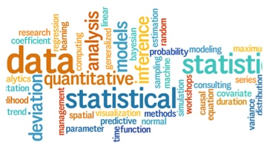
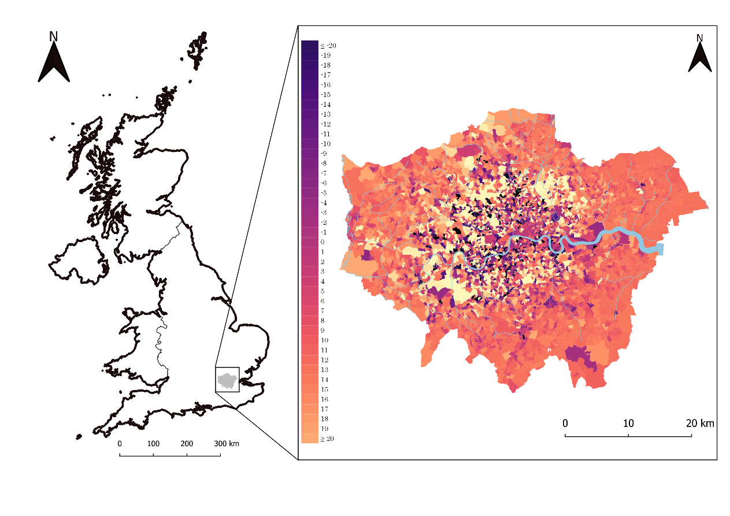


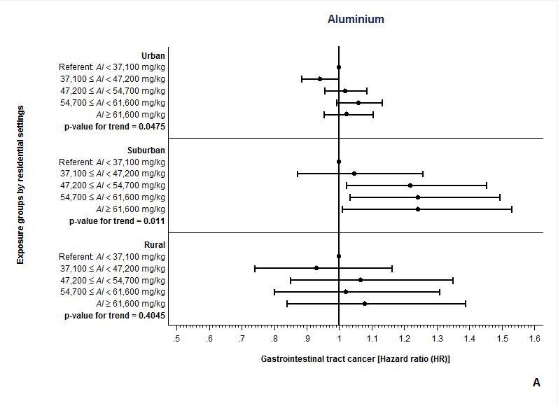

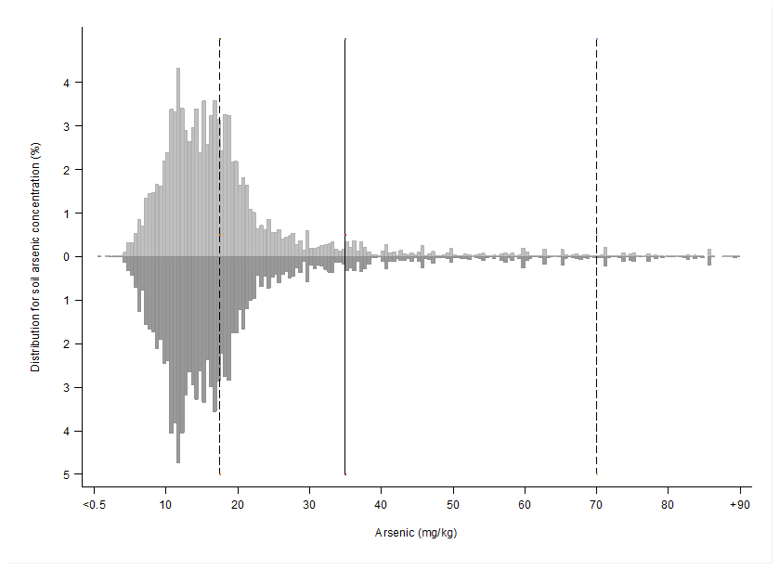
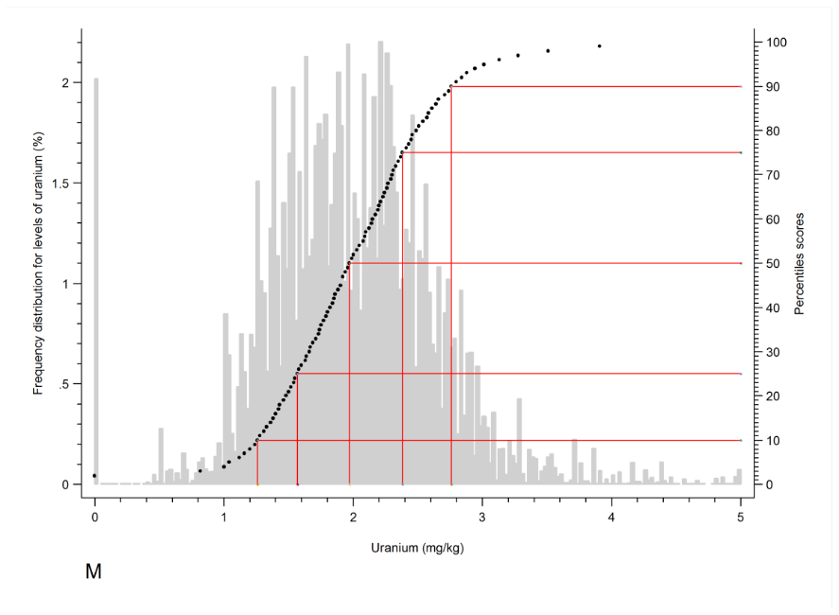
50
Notes:
Can perform statistics with ease
Has a huge range of functions for performing numerous impressive visualisations
Can carry out rapid for data management in cleaning of various data structures - these include but limited to simple spreadsheets as data frames, but you work with spatial data structures, network structures and many more....
Since its open-source, its free for the individual and companies - therefore its increasingly the industry standard for data analysis.

Slide 51
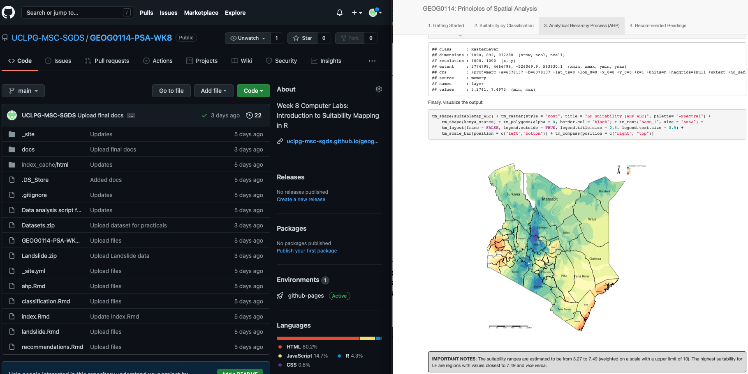
Why learn how to code in RStudio?
Efficiency
Automated tasks and data managing
Can recycle & reuse code scripts for new projects
Fosters good scientific practice
Transparency and replication (AKA reproducible research)
Creates log so anyone can follow in your footstep (i.e., github, gitlab etc.,)
You can literally pull-off some really creative stuff like generating websites, accessing tools via APIs etc.
Example: Working in RStudio and synchronising it with GitHub to not only use as a cloud back-up, but to generate a website through RStudio and GitHub for teaching MSc Students.
51

Slide 52
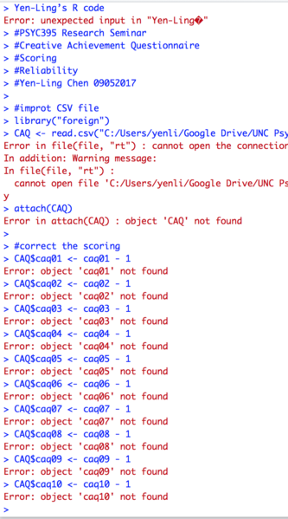
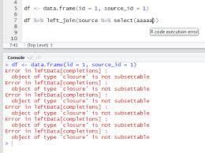
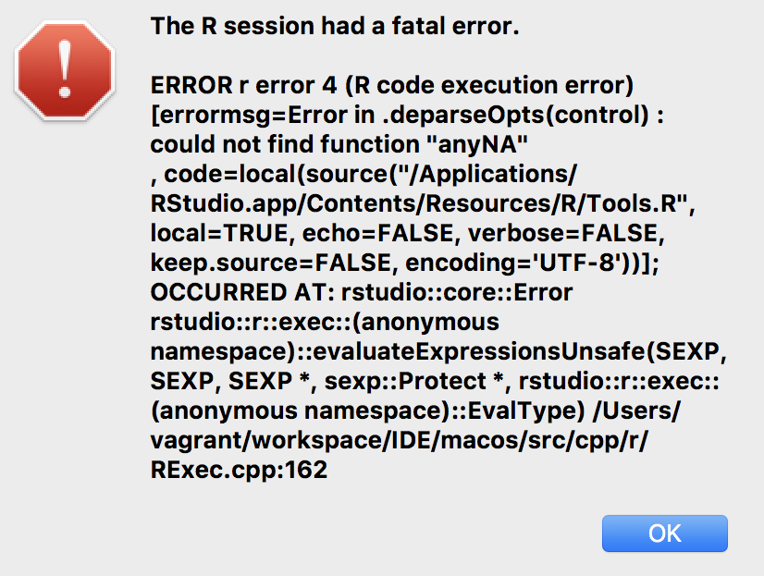
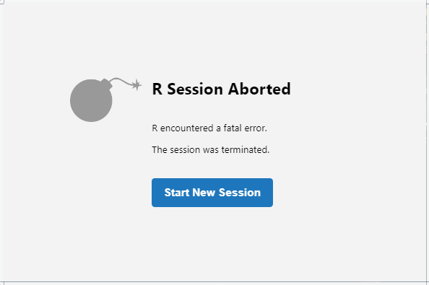
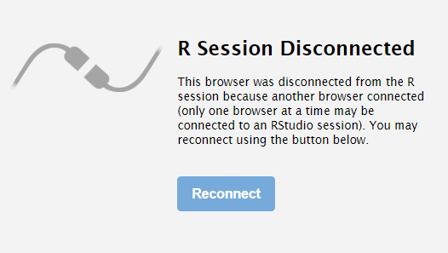
52

Slide 53
Live demonstration time – RStudio Server
53

Slide 54
RStudio Server: https://rstudio.data-science.rc.ucl.ac.uk/
To access RStudio Server with your personal computer, you will need the following conditions to hold:
Must be connected to the UCL Network i.e., WiFi (EDUROAM) or be inside UCL remote environment.
Must sign into RStudio Server with your UCL username and password with the above link.
54

Slide 55

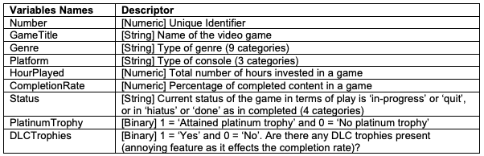
A Video gamer’s statistics
We have compiled the following information about the gaming habits of Anwar Musah (aka The-PhD-Gamer) across 3 console generations i.e., PlayStation 3, 4 and 5.
There are 161 game titles (~6,000 hours of game time) listed in the shared dataset (last updated 01/2024).
PSNProfiles (https://psnprofiles.com/)
Data Descriptor: [Downloadable Dataset]
We are going to use this data as a test dummy. We are just going to access RStudio server and then show how to import this dataset.
Then set you folks going for the practical material to prepare for the seminars on Thursday.
55

Slide 56
Summary
Importance of quantitative research methods (or statistics)
We have acquainted ourselves with some basic statistical terminologies (i.e., population, samples, parameters and statistics)
Types of variables & data types (i.e., continuous, categorical, dependent and independent variables)
Descriptive statistics (frequency distributions)
Introduced to RStudio
56

Slide 57
Any questions?
57

